Slide 1


HIMMOTTHAN SOCIETY
ANIMAL FEED INTERVENTION
August 3, 2022

Slide 2
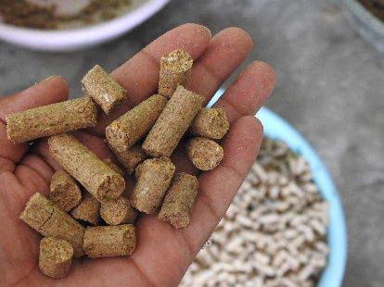
HIMMOTTHAN
ANIMAL FEED INTERVENTION
Animal Nutrition has pivotal role in livestock based value chain
Key focus on dietary needs of animals by balancing- protein, energy, vitamins & minerals in productive and economical mechanism and initiation
Transformational phase from ‘Conventional Home Made’ to ‘Compound Feed’ with use of maximum locally available raw material

Slide 3
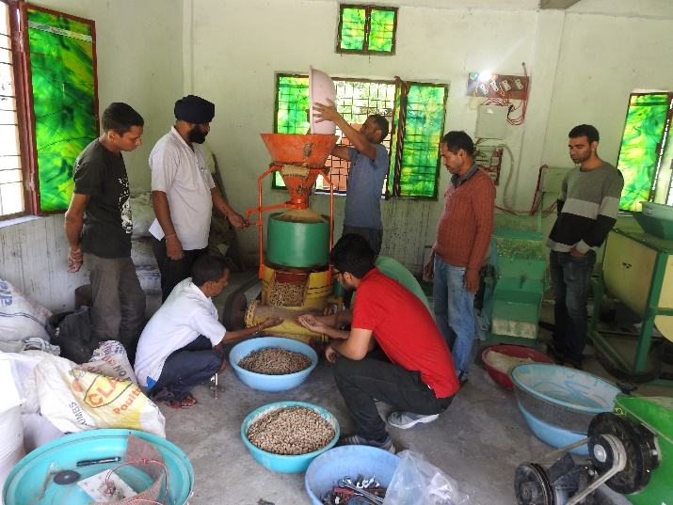
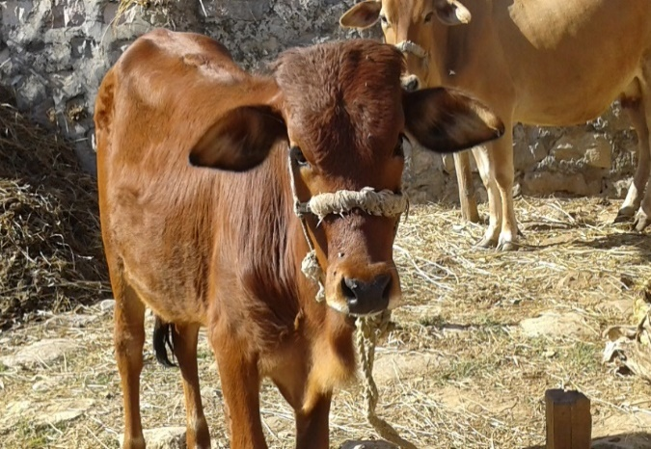
Nutrition provides better:
Maintenance
Growth
Production
Reproduction
Health
Issues in the Hilly region :
Lack of feed availability
Preference to home made feed
High Price of Cattle feed in the mountains

Slide 4
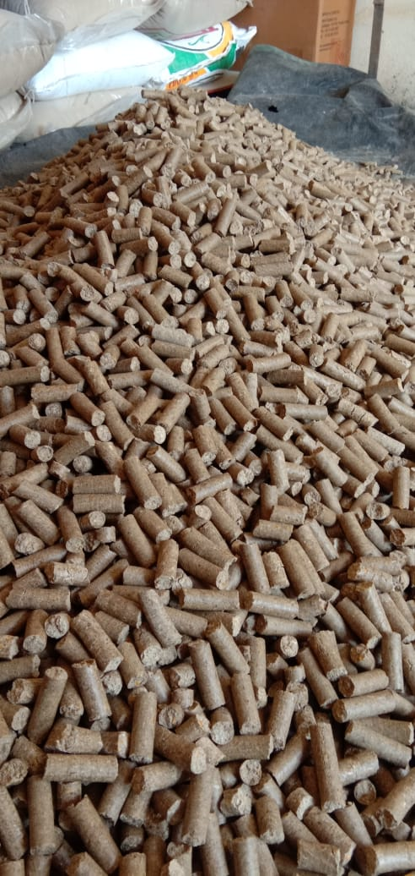
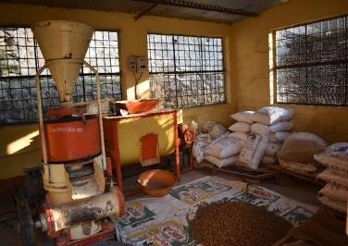
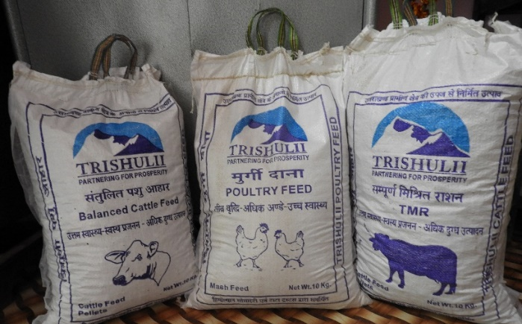
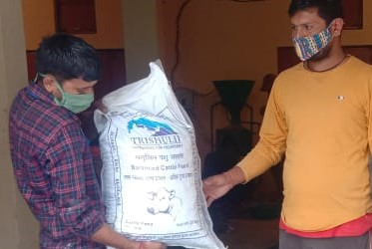
Animal feed
Idea Incubation/ piloting: 2015
Trials on feed composition
2016-18 by ILRI
12 feed units set up
2017-18
FPO led Enterprise mode 2018
Local millets and oil crops use in feed composition
Pelleting facility in 7 units
3 variants : Cattle feed, Poultry Feed, Goat/Sheep Feed
Direct employment : 12 youths

Slide 5
In 2016-18, International Livestock Research Institute, conducted research and trials to standardize the product as per hill cattle requirements by utilization of locally available raw material, especially millets (Finger millet and Barnyard millet)
Controlled field trials on livestock were carried out under the technical guidance of ILRI.
Himmotthan Society facilitate the Self Reliant Co-operatives in establishing animal feed units
Keeping in view the geographical challenges & raw material availability, 12 animal feed units are established. The feed is manufactured as per quality standard established by ILRI.
Units are catering local demand of feed
Feed is presently manufactured under uniform composition, keeping in view the seasonal availability of local grains under the guidance of nutritionist and regular testing of products to ensue adequate Crude Protein and Energy requirements
Product Lines:
Cattle feed (Mesh)
Cattle Feed (Pellets)
Poultry Feed (Mesh)
Goat Feed

Slide 6
Business Model
Raw Material Supply
APEX INSTITUTE- TPCL
Manufacturing & Quality Control
Total feed Units | 12
Pelleting facility | 7
Annual production | 3500 Qtls
Annual Sale | Rs.84 lakh
Profit to SRCs | Rs.2.97 lakh
Variants of feed | Cattle Feed, Poultry Feed, Goat Feed
Employment | 12
Average salary/Month | ₹8,500
Marketing & Distribution
CLUSTER LEVEL COOPERATIVE
SRC
Farmer
Retailer

Slide 7
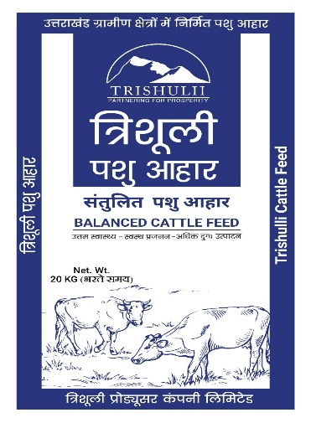
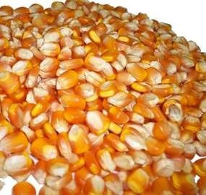
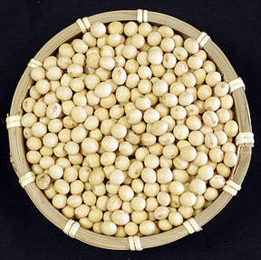
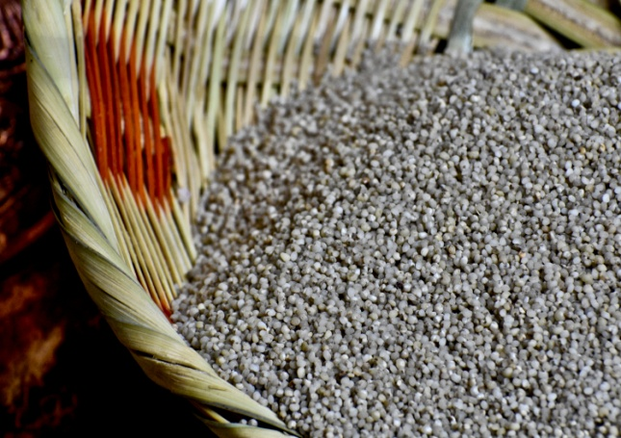
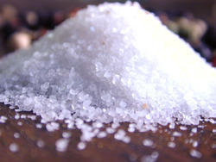
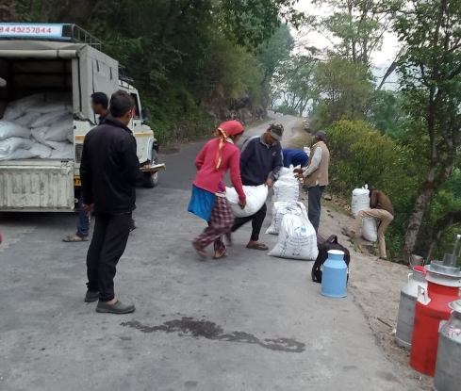
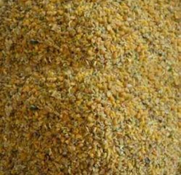
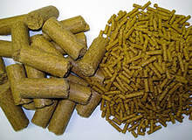
Animal feed Value Chain
Key challenges
High transportation charges
Wastage during transportation
Lack of of small manufacturing units
Un Skilled labor
Ensuring unform Quality under single brand
High cost of packaging material
Ensuring proper margin to retailers
Less awareness among community for balanced feed
High cost of raw material
Limited storage capacity
Lack of Capital for raw material purchase
Raw Material
Distribution
Production
Marketing
Interventions
In collaboration with M/S Namdhari Agro Industries, developed hill specific machines
Local youths trained by experts to handle feed manufacturing operations
Cadre of 12 youths trained for handling the feed operations and earning Rs7000-8000 per month
Composition by animal nutritionist based upon season raw material
Bulk packaging order
Brand Trishulii
Regular feed testing
Farmer awareness camps
Identification of whole sale trader for outside Raw material
Local raw material procurement at harvesting season
Combined working capital arrangement by Trishulii & SRC
Tie up with single transporter
Bulk order of raw material
Distribution charges reduced by Rs 100 /Qtls
Notes:
7

Slide 8
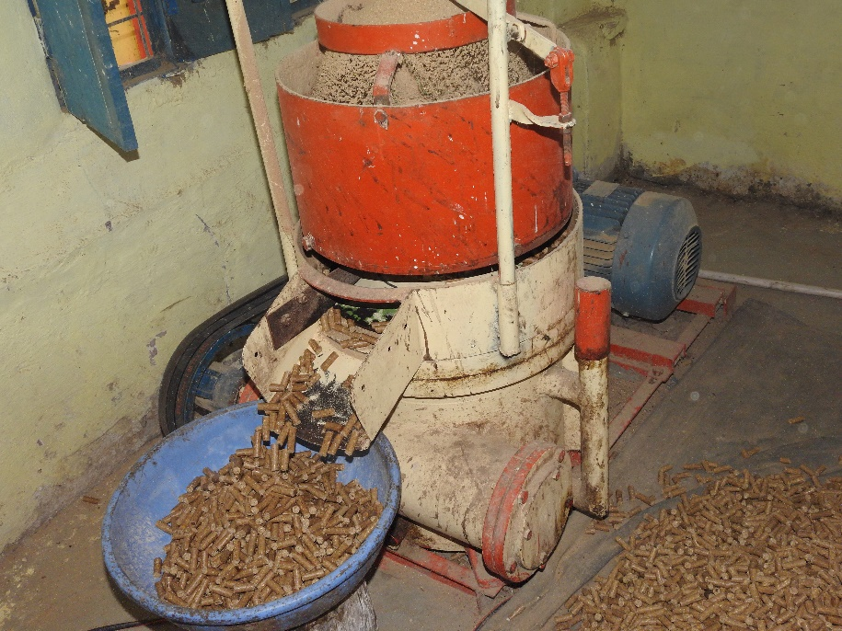
Interventions
  Pelleting facilities
  Whole sale traders tie up for raw material
  Tie- up with transporters
  Uniform Composition in all feed units
  Regular Feed testing
Major competitors- Godrej, Tara, SP, Kapila, Vardaan, Gwala.
Price of our brand is higher than 3 competitors and equal to 2 competitors
Our Storage capacity per month- 50 MT
Market share 30% in local cluster level market
Average 41% of Milk Pourer purchasing feed from SRC
Average 32 % of feed purchased by Milk Pourer
68% of feed is sold in cluster level open market
Impacts
  Raw material cost reduction- Rs 150/Qtls
  Distribution charges reduction – Rs 100 Qtls
  SRC margin- Rs 100/Qtls, TPCL margin- Rs 100/Qtls

Slide 9
Business Projections
Year | QTLs | Turn Over in lakh | Purchase Cost in lakh | Operational Cost in lakh | Profit in lakh | % Profit-Loss
2021-22 | 3289 | 78.8 | 74.6 | 1.6 | 2.6 | 3%
2022-23 | 4638 | 102.6 | 89.2 | 13.3 | 0.1 | 0%
2023-24 | 6962 | 161.0 | 134.0 | 23.3 | 3.8 | 2%
2024-25 | 8270 | 193.4 | 150.0 | 29.7 | 13.7 | 7%
2025-26 | 10210 | 240.3 | 185.3 | 34.3 | 20.6 | 9%

Slide 10
Future Plans
Working Capital
Credit Cycle
Quality control
Brand Awareness
Output | Outcome | Impact
Total 15 animal feed manufacturing units operational in project area. Scalability of production from 3000 Qtls to 9300 Qtls per annum | Rs 2 crore annual turnover of animal feed sale Direct employment to 15 youths Indirect employment to 18 youths | Productivity enhancement of animals Annual profit of upto Rs 11 Lac to Self-Reliant Cooperatives Easy access to quality feed
Cluster level market Study
Storage Capacity
Production efficiency of machines
Working Capital
Credit cycle

Slide 11
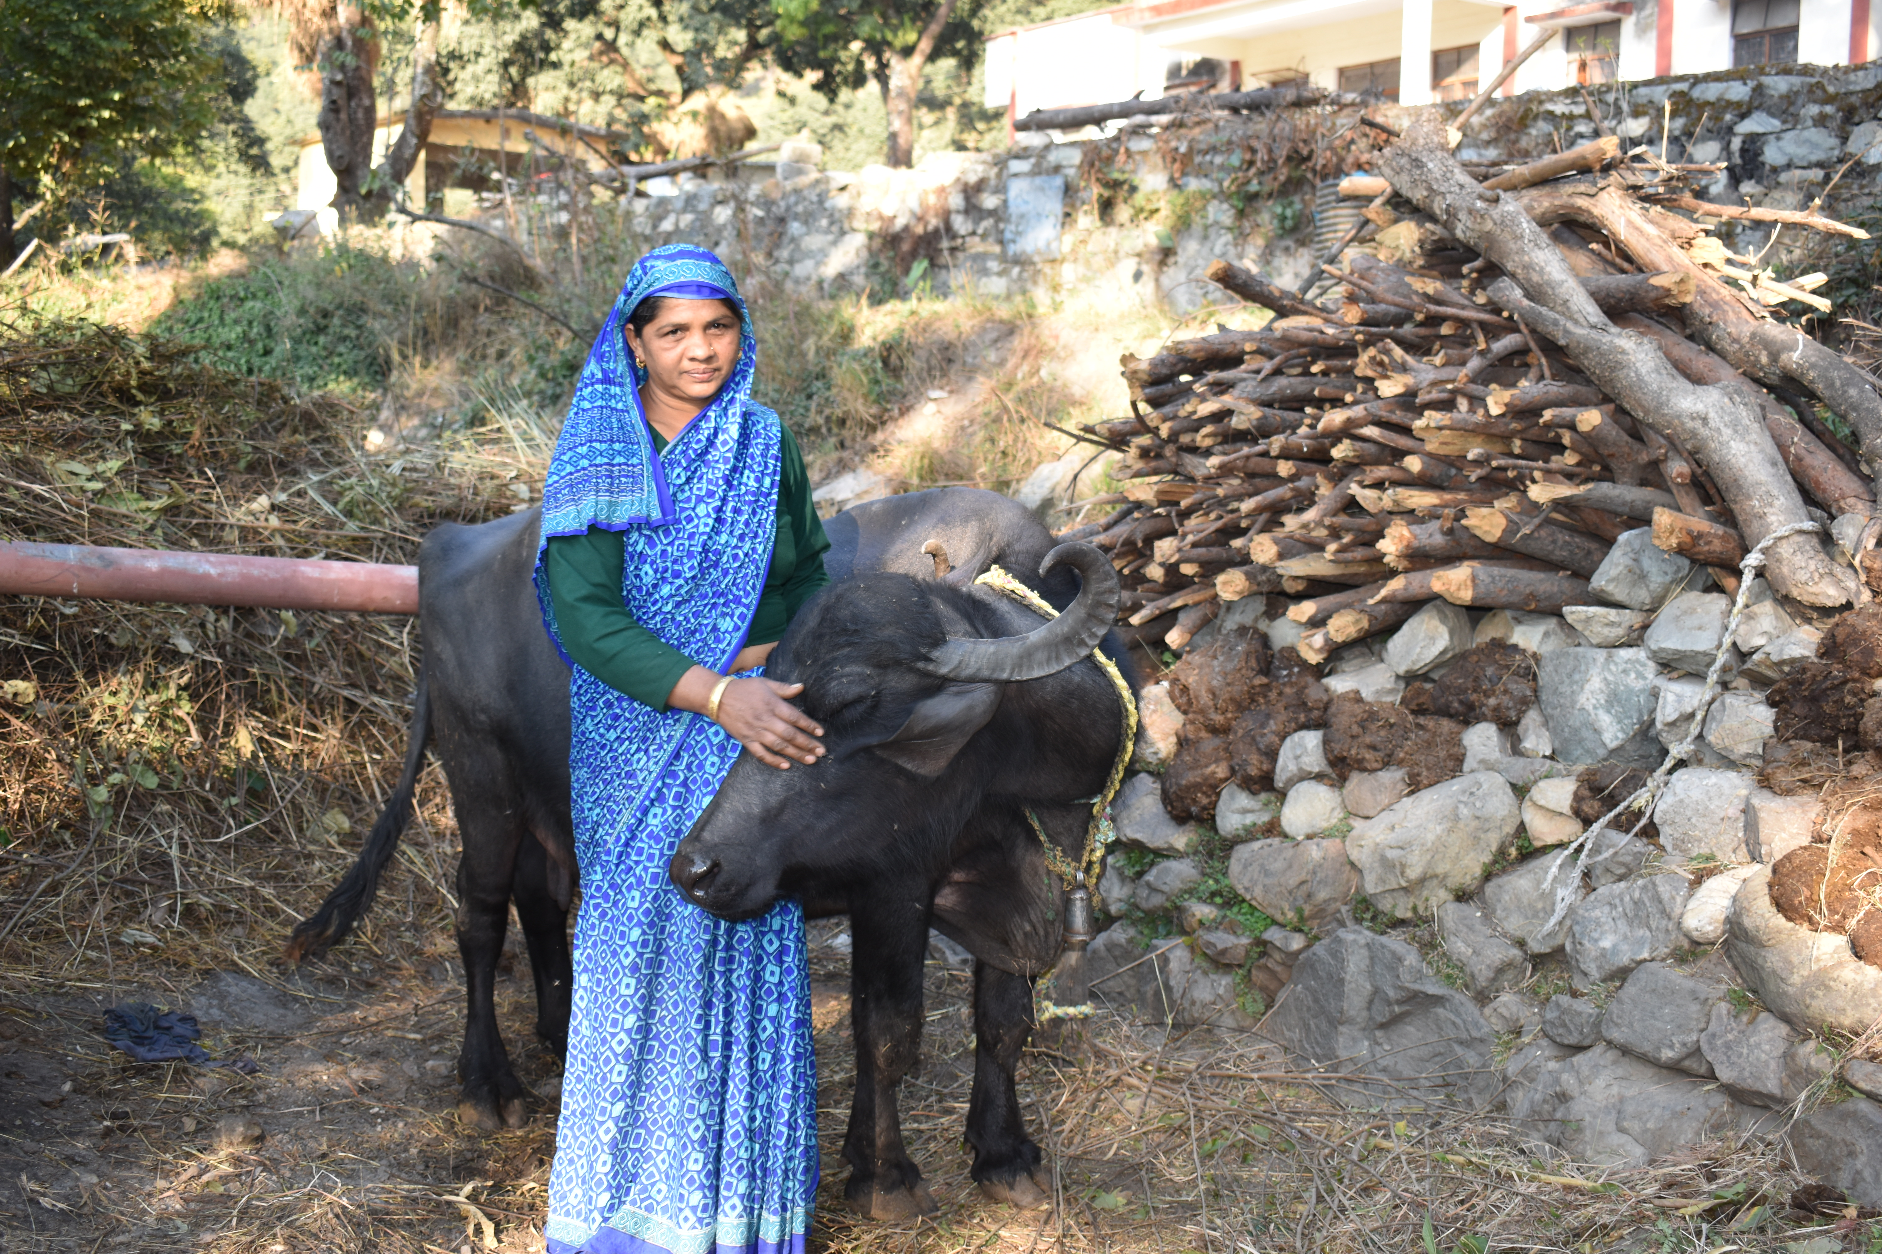
Thank you
for the kind attention!!

